Slide 1
Science Activity Accreditation
Abilmazhinov S., Minakov N., Niyazova D.

Slide 2
Introduction
SAA platform is a prototype of a system for automating the process of obtaining scientific accreditation of a university, which provides the end user with the ability to create, edit and confirm documents on the platform

Slide 3
Project goals:
Licensing of scientific activities of the university
Optimization of the activities of university employees
Compliance with international standards

Slide 4
Relevance
The project is relevant, since there are no such projects in Kazakhstan, that is, there are no competitors. As we know, ensuring the educational process at the appropriate level directly depends on the qualifications of teachers, including on their scientific activities. Therefore, the process of university accreditation is a relevant topic for every university.
Our project solves important problems like:
Accelerating the process of collecting, confirming and updating data, compiling reports
Reducing the time spent by the teaching staff on the registration of scientific activities
Visual representation of existing achievements of employees
Reducing the load on the university science department

Slide 5





Existing accounting services:
Существующие сервисы учёта:

Slide 6
Analogs
ИСУ ПГТУ
Implemented in PHP, using CMS WordPress
ИСТИНА
Operates at the Moscow State University. Lomonosov
www.istina.msu.ru
ИСУ НГТУ
Also used for student tracking, scheduling and campus distribution
www.ciu.nstu.ru

Slide 7
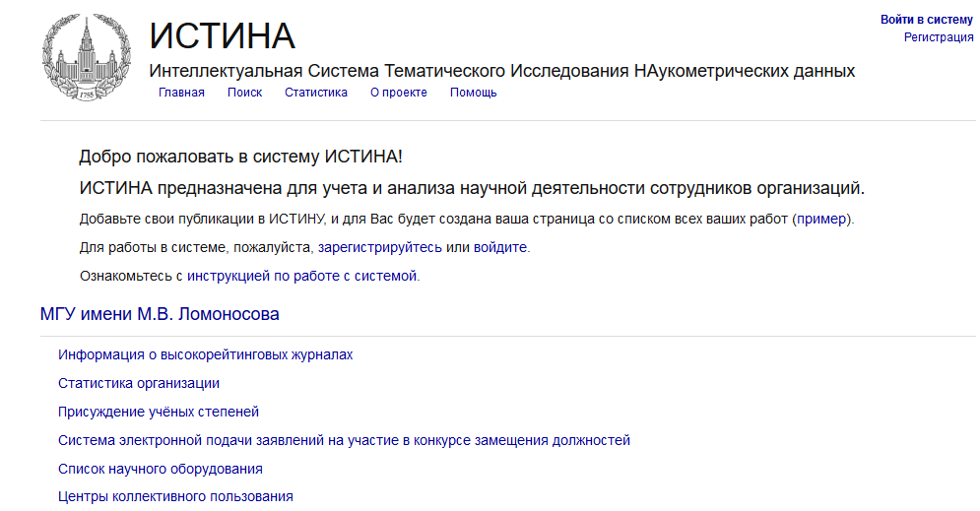

Slide 8
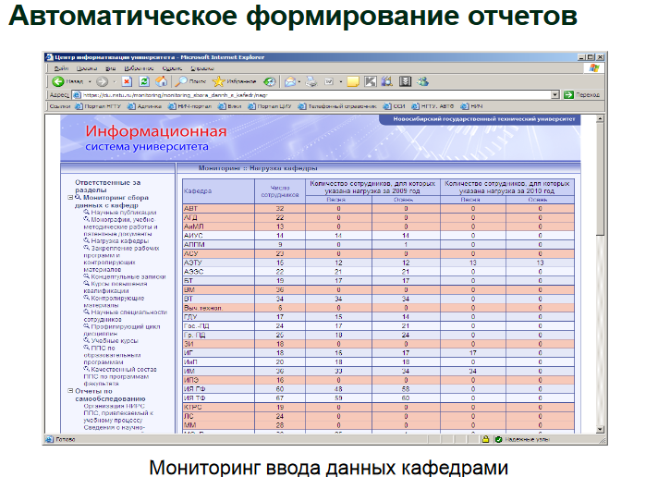

Slide 9
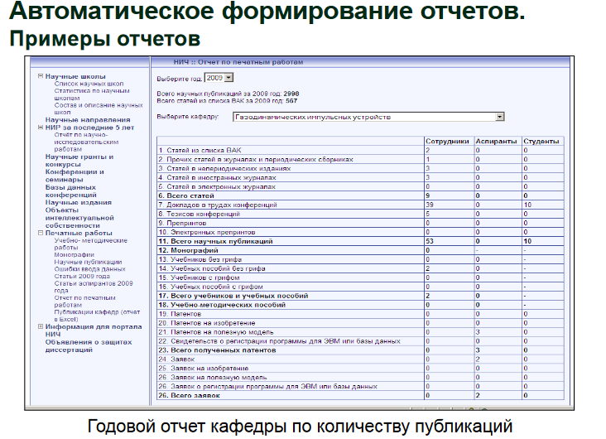

Slide 10
Using ML
Implementation of a neural network into the project, which will search for all publications of teachers through search engines, as well as constant monitoring of new publications of the teacher. As soon as any publications are found, teachers will automatically be prompted to add the same publications to the platform.

